Slide 1

Flight Ticket Booking (FTB)
Chibuisi Kelvin Amiaka
Ali Mohammad Ahmadi
July 2019

Slide 2
Problem Statement
Aero Travels is an airline reservation company. It has numbers of branches spread across the world. The Aero Travels manages flight operations manually, but as its customers grow in number, managing flight operations manually becomes difficult and time consuming. So, it would be better to use an automated system.

Slide 3

Users
Functionalities
Schedule Flights
Book Flights
Search Available Flights
Verify Booking
Admin
Travel Agents
Customers

Slide 4
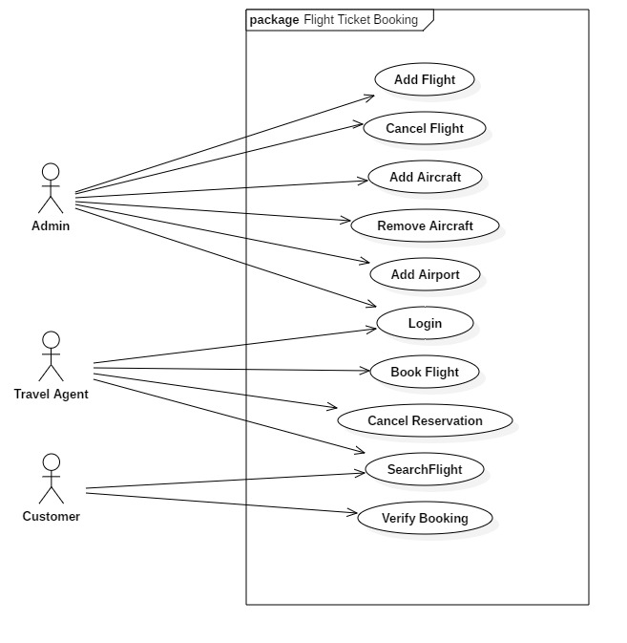
Use Case Diagram

Slide 5
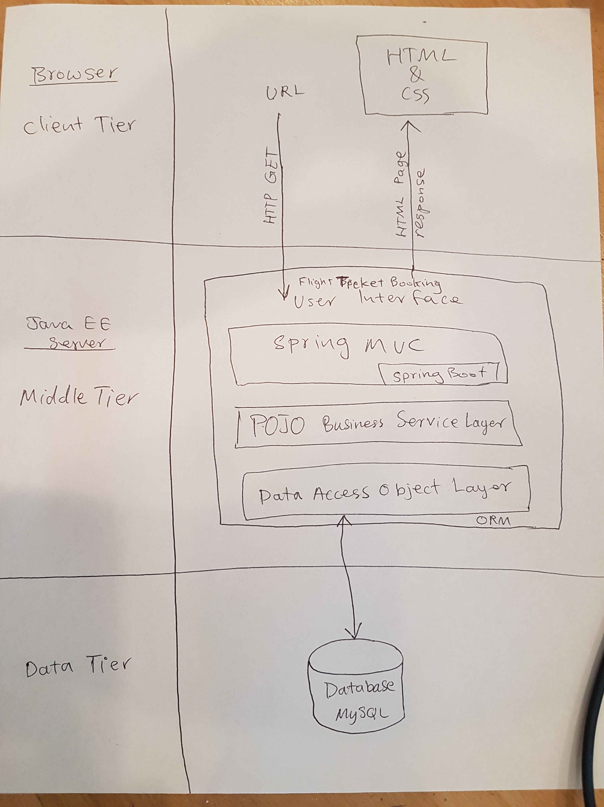
System
Architecture

Slide 6
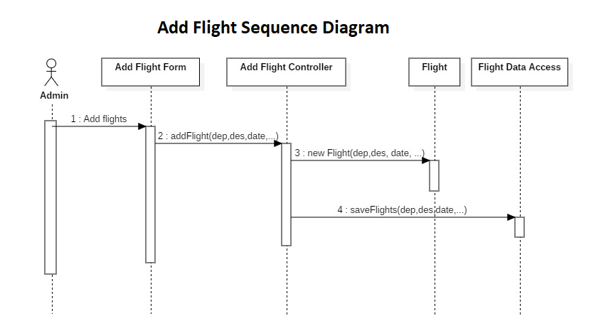
Sequence
Diagram for
Schedule
Flight

Slide 7
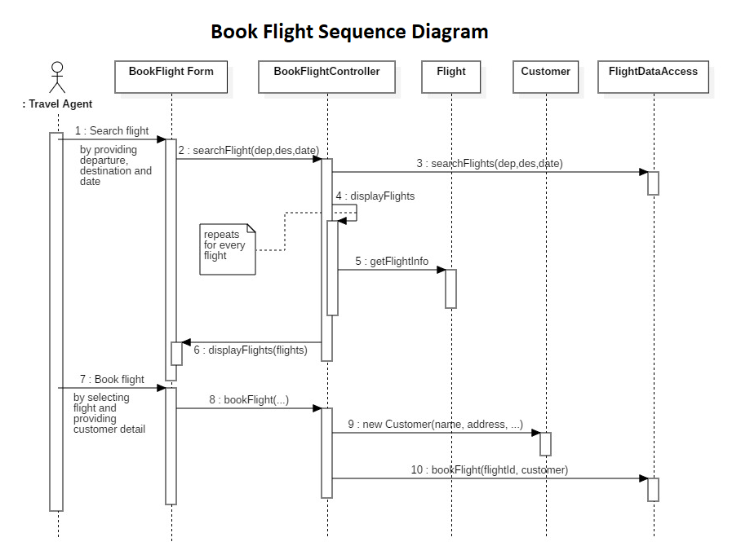
Sequence
Diagram for
Book Flight

Slide 8
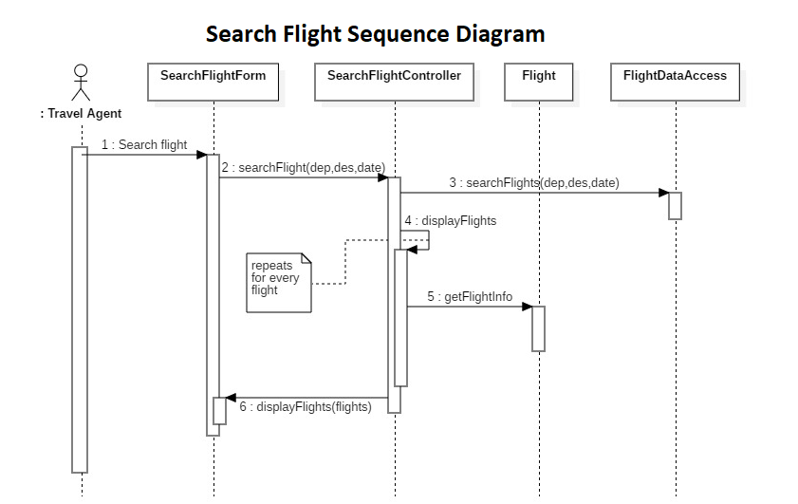
Sequence
Diagram for
Search
Flight

Slide 9
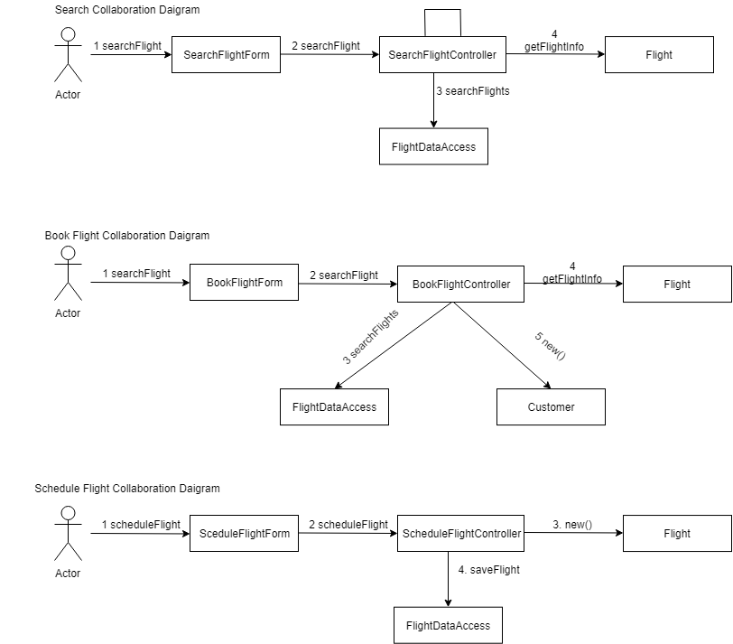
Collaboration
Diagram

Slide 10
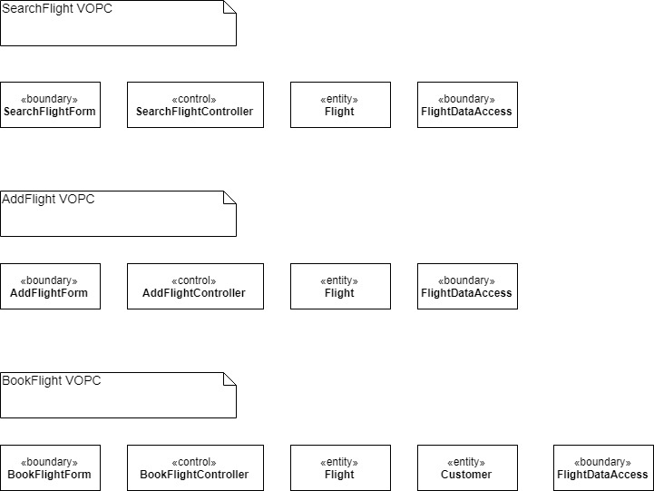
VIEW OF PARTICIPATING CLASSES

Slide 11

THANK YOU!

